Slide 1
Restaurant Market Analysis & Expansion Strategy 9 Major Cities · 3 Price Segments · 13 Cuisine Categories Restaurant Market Intelligence Report that identified expansion opportunities by analyzing restaurant density, cuisine demand, customer ratings, and pricing across Indian cities. Based on the analysis, I recommended cities and cuisine segments with strong growth potential
9
Cities Analyzed
Across India
8,799
Total Restaurants
Avg Rating
3.65
(top city) Kolkata
Avg Price
348.4

Slide 2
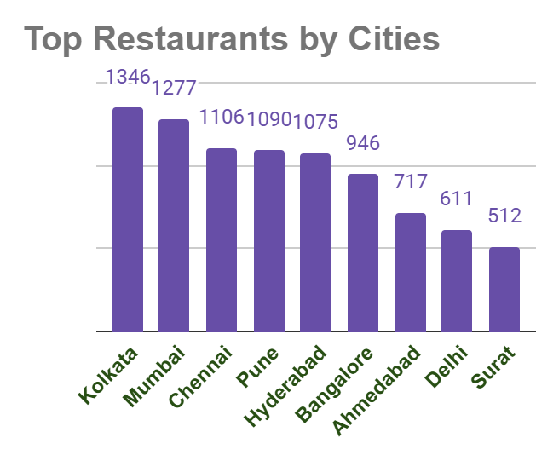
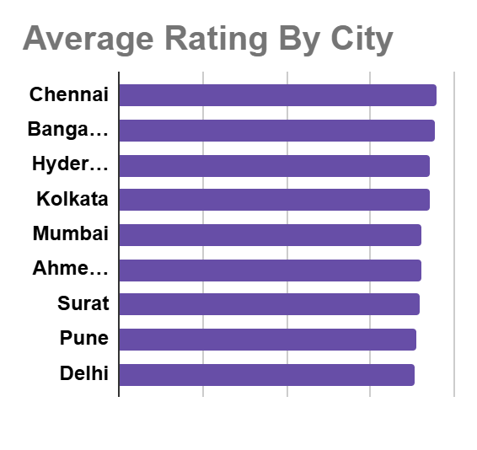
City-Wise Restaurant And Average Rating
Kolkata leads in both restaurant and highest average rating , making it the strongest overall market
Delhi ranks 8th in density and has a concerningly low avg rating suggesting quality issues.
Surat has the fewest restaurants with the lowest rating
Ahmedabad shows moderate with below-average ratings — an opportunity if quality gaps are filled.

Slide 3
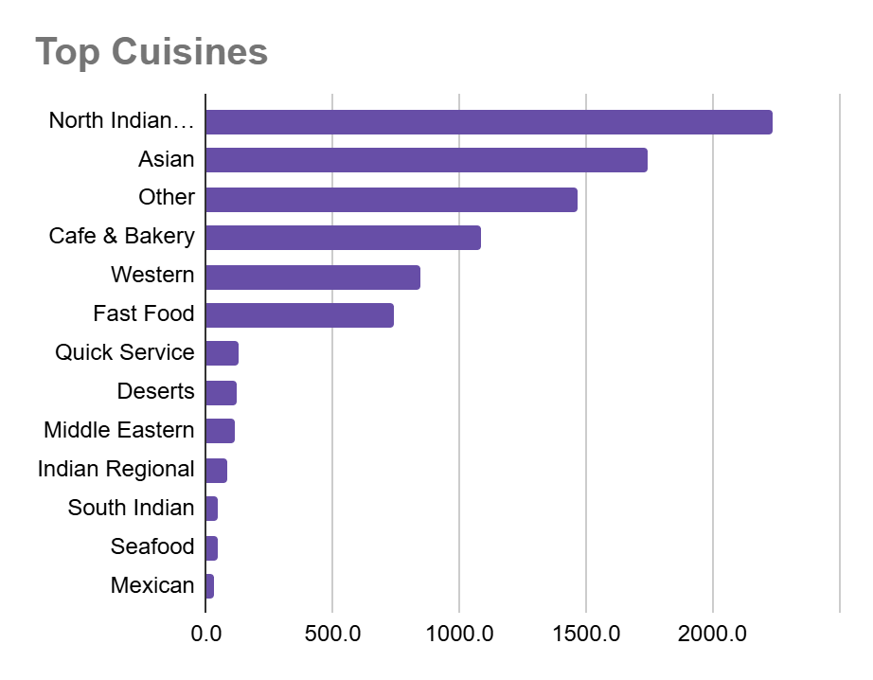
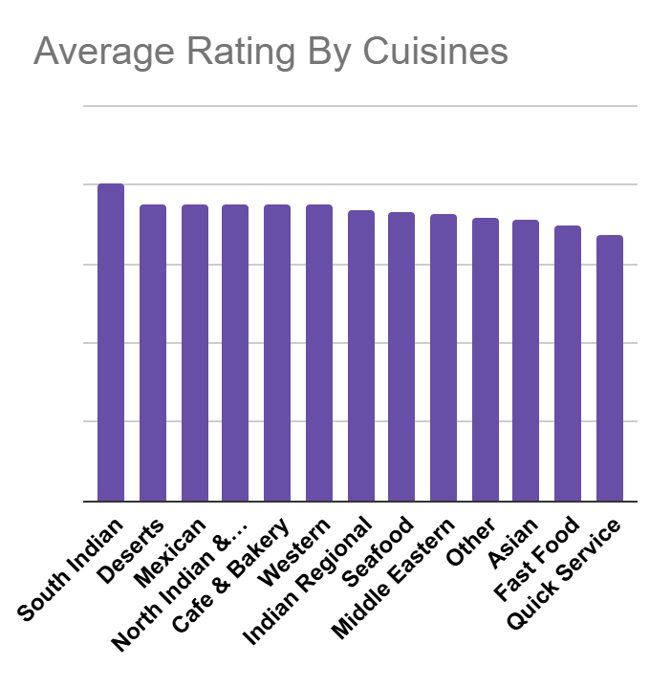
Cuisine Demand & Rating Analysis
North Indian dominates demand (2,500+ listings) but highly competitive
South Indian achieves the highest average rating despite lower volume quality niche opportunity
Mexican & Middle Eastern cuisines show strong ratings with low competition underserved niche markets

Slide 4
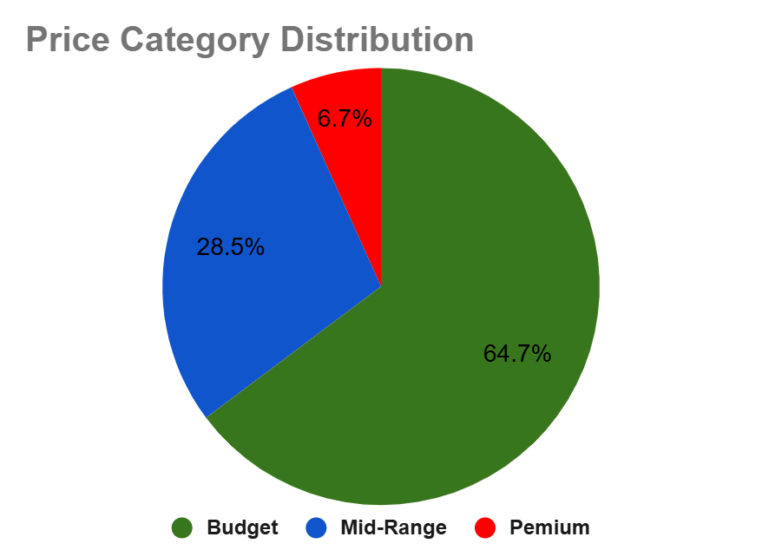
Price Category Distribution
The Indian restaurant market is overwhelmingly budget-oriented, with nearly two-thirds of all restaurants positioned in the affordable segment
Budget (64.7%): Largest segment
Mid-Range (28.5%): Growing aspirational tier Premium (6.7%)

Slide 5
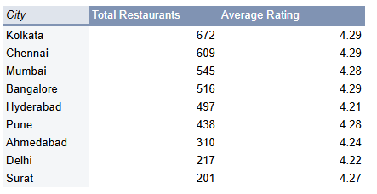
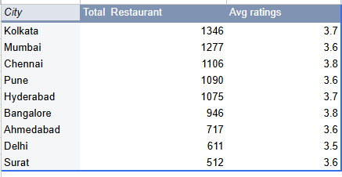
City Scoring Matrix
Cities with Highly Rated Restaurants
Total no. of Restaurants with Rating
Bangalore, Ahmadabad and Surat has great Potential for Expansion
Surat is Underserved Gem with low restaurants but highly Rated city

Slide 6
Final Business Recommendations
Best City for Expansion:
Ahmedabad, Bangalore and Surat Ahmedabad has only 717 restaurants with moderate competition a new quality restaurant can rapidly dominate.
Bangalore 946 offers strong tech-savvy demographics and a growing food culture
High-Demand Cuisines to Target: North Indian + South Indian:
North Indian commands the highest volume (2,500+ listings) making it essential for reach.
South Indian earns the top average rating combining both maximizes satisfaction.
Optimal Price Range: Mid-Range with Budget Entry
The mid-range segment (28.5%) is growing fastest, underserved relative to budget (64.7%). Launch with a budget menu to capture volume, then upsell mid-range Products.
Premium (6.7%) is viable only in Kolkata, Mumbai, or Chennai.
Underserved Markets:
Surat & Delhi (with Quality Focus) Surat has the lowest restaurant density (512) and lowest average rating (3.6) a well-executed quality restaurant here faces almost no quality competition.

